Slide 1


BASIC DETAILS OF THE TEAM AND PROBLEM STATEMENT
PSID: KVH-011
Problem Statement Title: Citizen safety app for protection against cyber crimes Team Name: cyber commands aliens
Team Leader Name: Joyee Ray
Institute Code :C-7623
Institute Name: Mgm’s College Of Engineering , Nanded

Slide 2
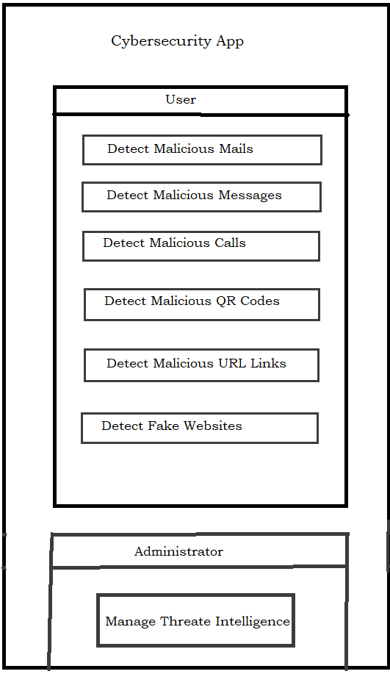










idea approach /details:
Solution Description
This app provides comprehensive protection to users from cyber attacks related to wallet and banking, emails, messages, social media, calls, QR Codes, and URL links. With advanced security measures such as encryption, authentication, and real-time threat detection.
Our app Solution
Email and Message Analysis :analysing the content, headers, and metadata of incoming emails and messages to detect potential phishing attempts, scam messages, and other malicious activities
Call Detection and Analysis: analyze incoming calls and detect potential spoofed calls, scam calls, and other malicious activities.
QR Code Scanning: .Analyze the QR code content and metadata to
detect potential malicious QR codes, such as those that may lead to phishing websites or contain malicious payloads.
Technology stack
URL scanning and Web content analysis: Use web content analysis techniques to scan the content of websites for potential phishing attempts, malware, and fake websites.
Wallet an Banking Protection , Real-time Threat Intelligence, User-Friendly Interface, Continuous Updates and Improvements
Privacy and Security Measures: maintaining the privacy and security of the app

Slide 3









Use Cases
Dependencies /Show stopper
Scan Emails for Malicious Content:
This use case involves scanning incoming emails for malicious content, such as phishing links, malware, or viruses that may target the user's wallet or banking accounts .
Scan Text Messages for Malicious Content:
This use case involves scanning incoming text messages for malicious content, such as phishing links, malware, or viruses that may target the user's wallet or banking accounts.
Scan Phone Calls for Fraudulent Activity:
This use case involves monitoring incoming and outgoing phone calls for fraudulent activity, such as phone scams or impersonation attempts.
Scan QR Codes for Malicious Content:
This use case involves scanning QR codes for any malicious content, such as phishing links or malware that may lead to a cyber attack on the user's wallet or banking accounts.
Block Malicious Content:
This use case involves blocking any malicious content that is detected by any of the above scan use cases, in order to prevent any damage to the user's wallet or banking accounts.
Monitor Social Media Accounts for Suspicious Activity:
This use case involves monitoring the user's social media accounts for any suspicious activity, such as phishing attempts or suspicious logins.
Secure Wallet and Banking Accounts:
This use case involves providing secure authentication mechanisms and transaction verifications to ensure the safety of the user's wallet and banking accounts.
Alert Users of Potential Cyber Attacks:
This use case involves alerting users of any potential cyber attacks that are detected by the app, and providing guidance on how to respond and protect themselves.
Record Activity:
This use case involves recording and logging all activity related to malicious content and potential cyber attacks, such as the content detected, the source, and the action taken. This can be useful for analysis and reporting.
Access to Accurate and Timely Threat Intelligence
Integration with External APIs and Databases
Legal and Privacy Considerations:
False Positives and Negatives
Evolving Threat Landscape
Resource and Performance Constraints
User Interface and User Experience:
Testing and Validation:
Youtube link :
Github link:
3

Slide 4
Stream
Position in team
Name of Team Member
Branch
Year
Sr. No.
1 | Joyee Ray | Btech | IT | III | Team Leader
2 | Sonali Dhananjay Joshi | Btech | IT | III | Backend Developer
3 | Pratiksha Mehatre | Btech | IT | III | Front end developer
4 | Tanzeela Sameen | Btech | IT | III | UI Designer
5 | Shoeb Ahmad Siddiqui | Btech | IT | III | Backend Developer
6 | Aishwarya Shivareddy | Btech | IT | III | Database
Sr. No. | Name of Mentor | Category (Academic/ Industry): | Expertise (AI/ML/Blockchain etc): | Domain Experience (in Years )
1 | A.B Waghmare | Academic
2 | R.S Bisen | Academic

